Slide 1

AlgoUniversity
PRESENTATION
In this presentation, we will focus on the problems facing by AlgoUniversity and possible solutions.

Slide 2

BRANDING
AlgoUniversity focuses on being affordable without compromising quality, as the monthly fee could be less than ₹4582 per month, which is less than your monthly mess charges.
Courses they provide are for Data Structures & Algorithms and Full Stack Development.
SUGGESTIONS
“TRANSFORM YOUR CAREER WITH US AT AN AFFORDABLE PRICE”
AlgoUniversity can also provide courses in AI/ML, Data engineering and DevOps which will bring variety and are in high demand.
Maybe this fee is too low, but colleges don’t spend that much on courses, it can change if we can bring full fee refund if the student is not placed.
We can use an Income Share Agreement (ISA), which can boost trust, but it can create issues in recovery. We will have to spend extra money on recovery operations and it will decrease working capital for day to day operations

Slide 3

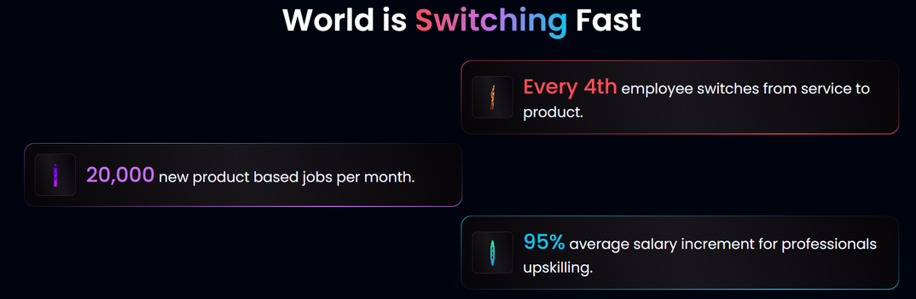
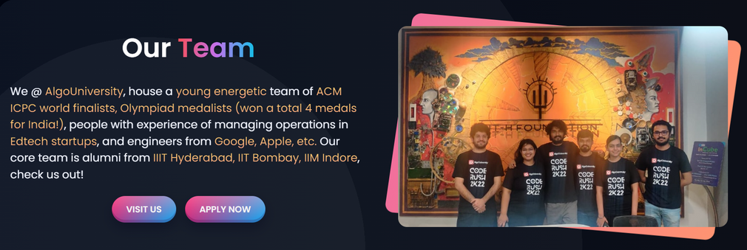
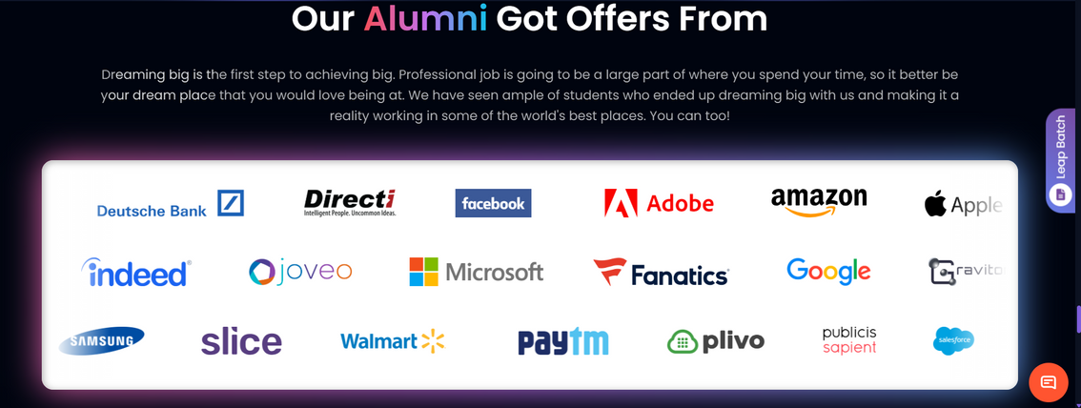
WEBSITE
1
PROBLEMS
Outdated design with inconsistent fonts, colours, lower-quality images and cluttered layout.
2
Black background creates a sense of mystery instead of trust.
3
Top Recruiter should be on top, but the website has them in bottom

Slide 4

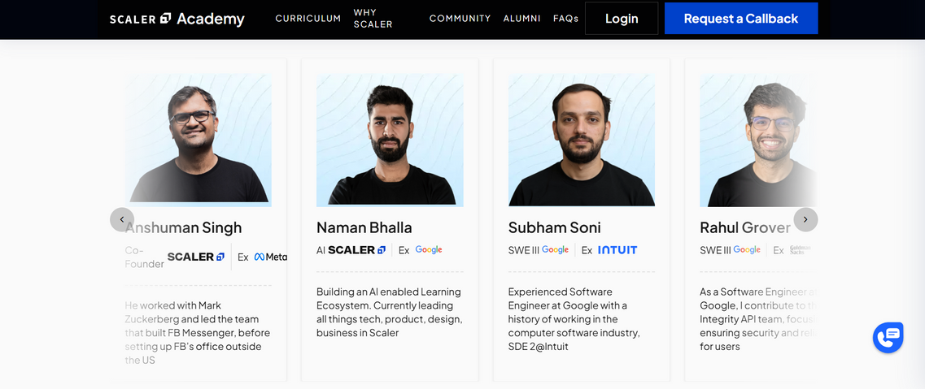
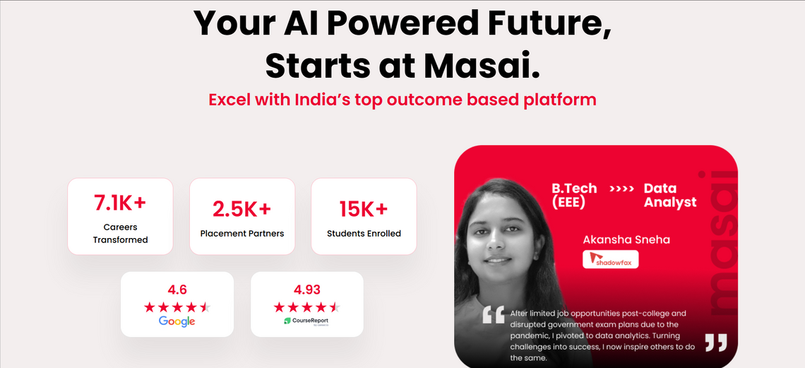
COMPETITORS WEBSITES
There are many problems in the website, and since it is the most important platform where students will buy courses, the bad design is a primary reason for the low conversion rate, especially when competitors like Scaler and Masai have far better websites. A better website should be created as soon as possible.
SUGGESTIONS
Avoid black backgrounds since black indicates mystery; instead, pick colors that signify trust, such as blue or green.
Use a consistent and modern color palette with professional fonts.
Highlight key information like outcomes, curriculum, and top recruiters upfront.
Improve UI with clean layouts, smooth navigation, and well-designed CTAs.
Present testimonials, alumni success stories, and salary comparisons with engaging visuals.
Ensure logos, icons, and graphics are properly styled and placed to reflect premium branding.

Slide 5

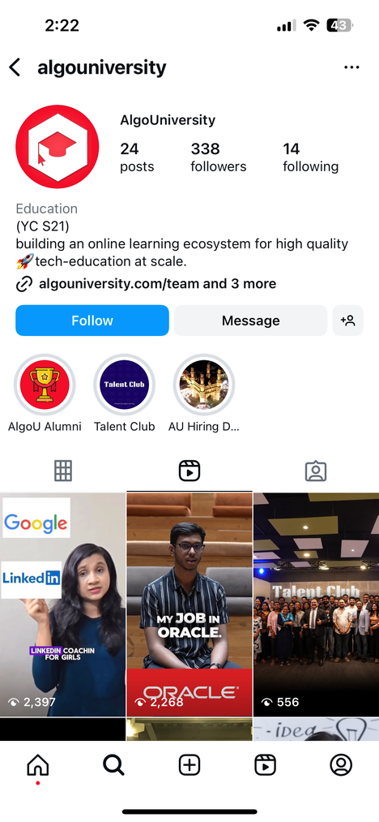
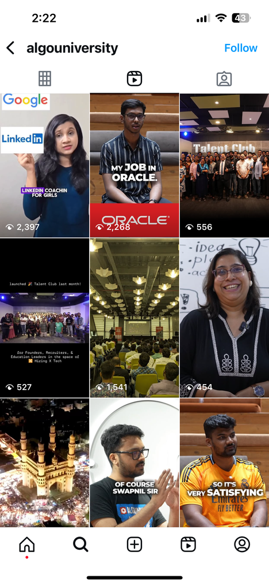
INSTAGRAM PRESENCE
AlgoUniversity’s Instagram presence is currently weak, with only 338 followers and 24 posts. This can be attributed to limited and less engaging content. For instance, the latest reel has poor sound quality, which creates a negative viewing experience. Additionally, some videos lack proper editing, consistent sound design, and standardized use of fonts and colors. These shortcomings reduce overall professionalism and limit audience engagement.
CONENT IDEAS
Start posting reels on top interview questions asked in big companies.
Highlight student placements, job openings, and industry insights to build credibility.
Post short clips of mentors and founders sharing career advice.
Share Common Mistakes in DSA Learning.
Launch a “DSA in 30 Days” Reel Series and explain a difficult topic in simple language.
Create a weekly crousel explaining weekly industry trends, new skills in the market and best question on different topics and share them on the community channel on Instagram

Slide 6
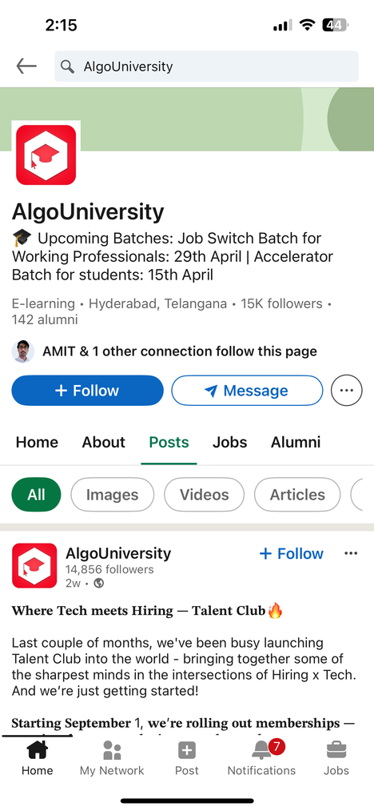
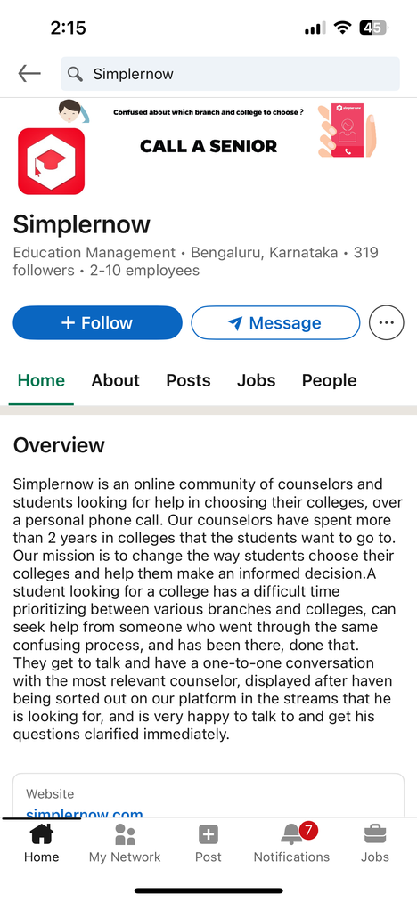
LINKEDLN PRESENCE
AlgoUniversity’s LinkedIn presence is relatively strong, with 15K followers. However, greater focus is needed on this platform since it is where our core target audience—students and professionals seeking career advancement—actively consumes content. An important concern is the existence of a page named SimplerNow that uses a logo similar to AlgoUniversity’s. This creates brand confusion and may dilute or degrade AlgoUniversity’s brand value. Addressing this issue through stronger brand guidelines and proactive monitoring is essential.
SUGGESTIONS
Post the Instagram reel directly, and post the job opening and genuine advice.
Change the logo as soon as possible.
Design the LinkedIn post properly, use better fonts and try to be consistent in design as much as possible across all online platforms.
In one of the videos, you used an AI voice. Don't use simple AI voices they don't sound professional

Slide 7
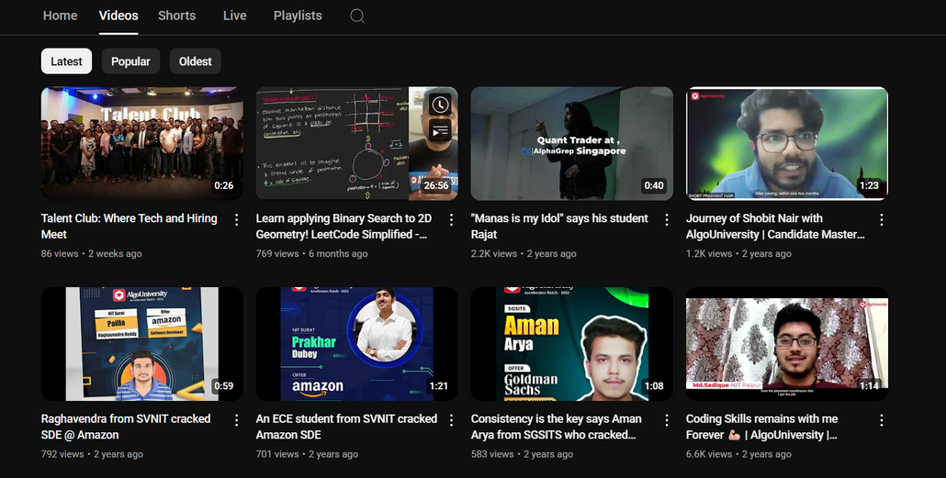
YOUTUBE PRESENCE
AlgoUniversity has an active YouTube channel with student success stories, coding tutorials, and event highlights. Some videos, like coding success stories, have gained decent traction (6.6K views), while others receive limited engagement (as low as 86 views). The channel suffers from inconsistent posting frequency, lack of standardized thumbnails and branding, and uneven video/audio quality.
This inconsistency reduces discoverability, professional appeal, and overall audience retention. Strengthening video production quality, maintaining a regular posting schedule, and creating a consistent visual identity will help AlgoUniversity position itself as a stronger authority on YouTube
SUGGESTIONS
Upload at least 2–3 videos per week to keep the channel active and build audience trust.
Create a mix of student success stories, DSA tutorials, interview prep, industry insights, and short-format reels.
Organize videos into playlists (DSA, placements, success stories, interview prep) for easier navigation.
Invite industry experts and alumni to create authority-driven content.
Use consistent thumbnails, fonts, colors, and intro/outro templates to strengthen brand recognition.

Slide 8

THANK YOU

